Slide 1
Information System Analysis and Design
Course Instructor:
Prof. Dr. Shamim H Ripon
Department of Computer Science and Engineering
East West University
Dhaka, Bangladesh

Slide 2

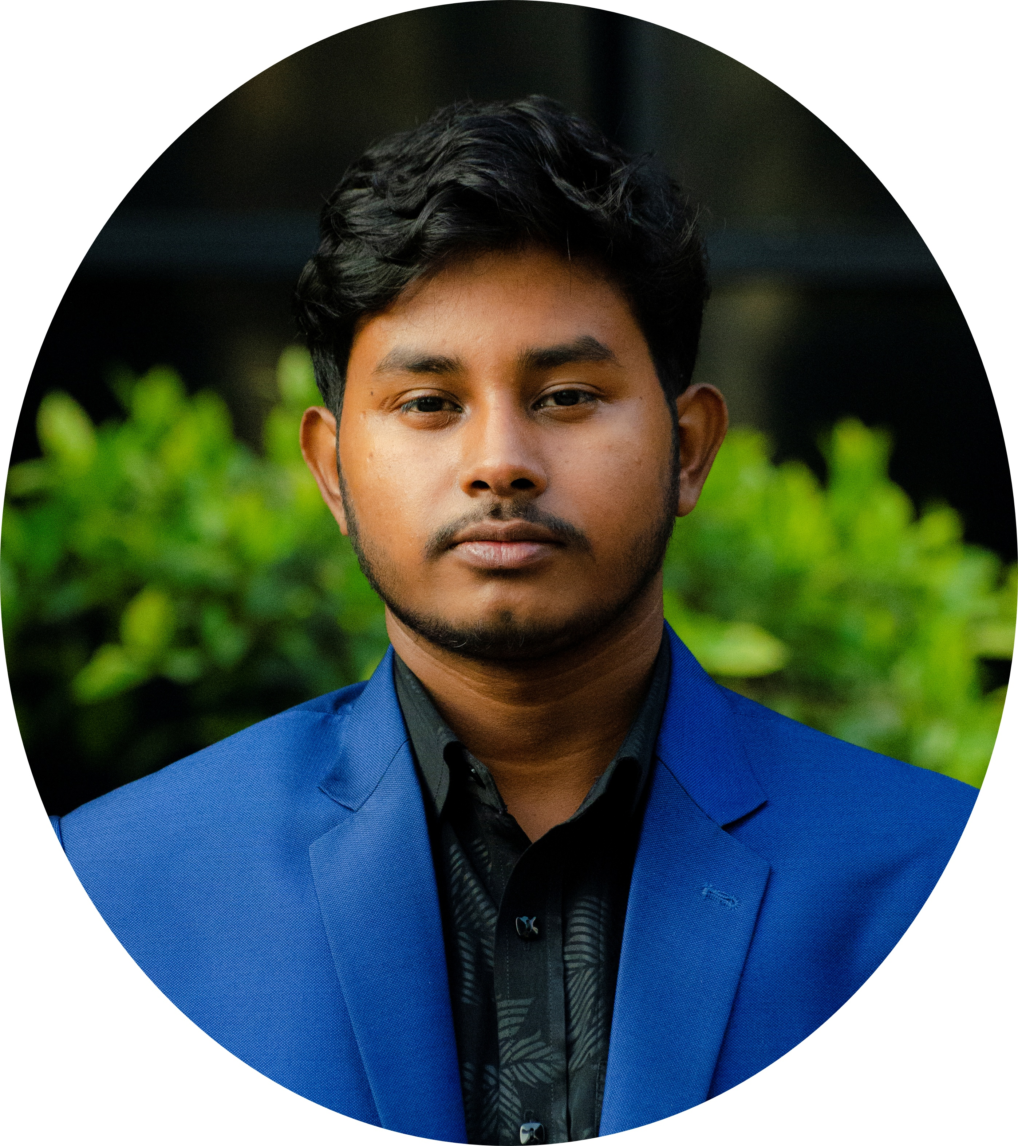
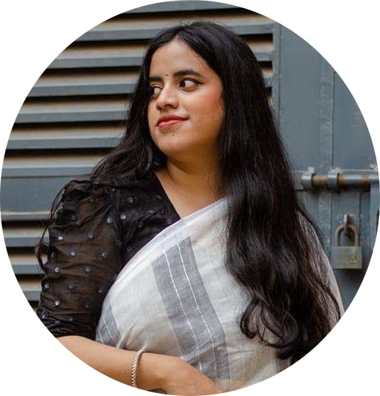
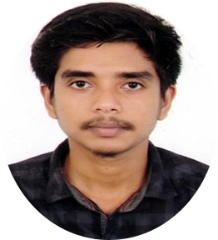
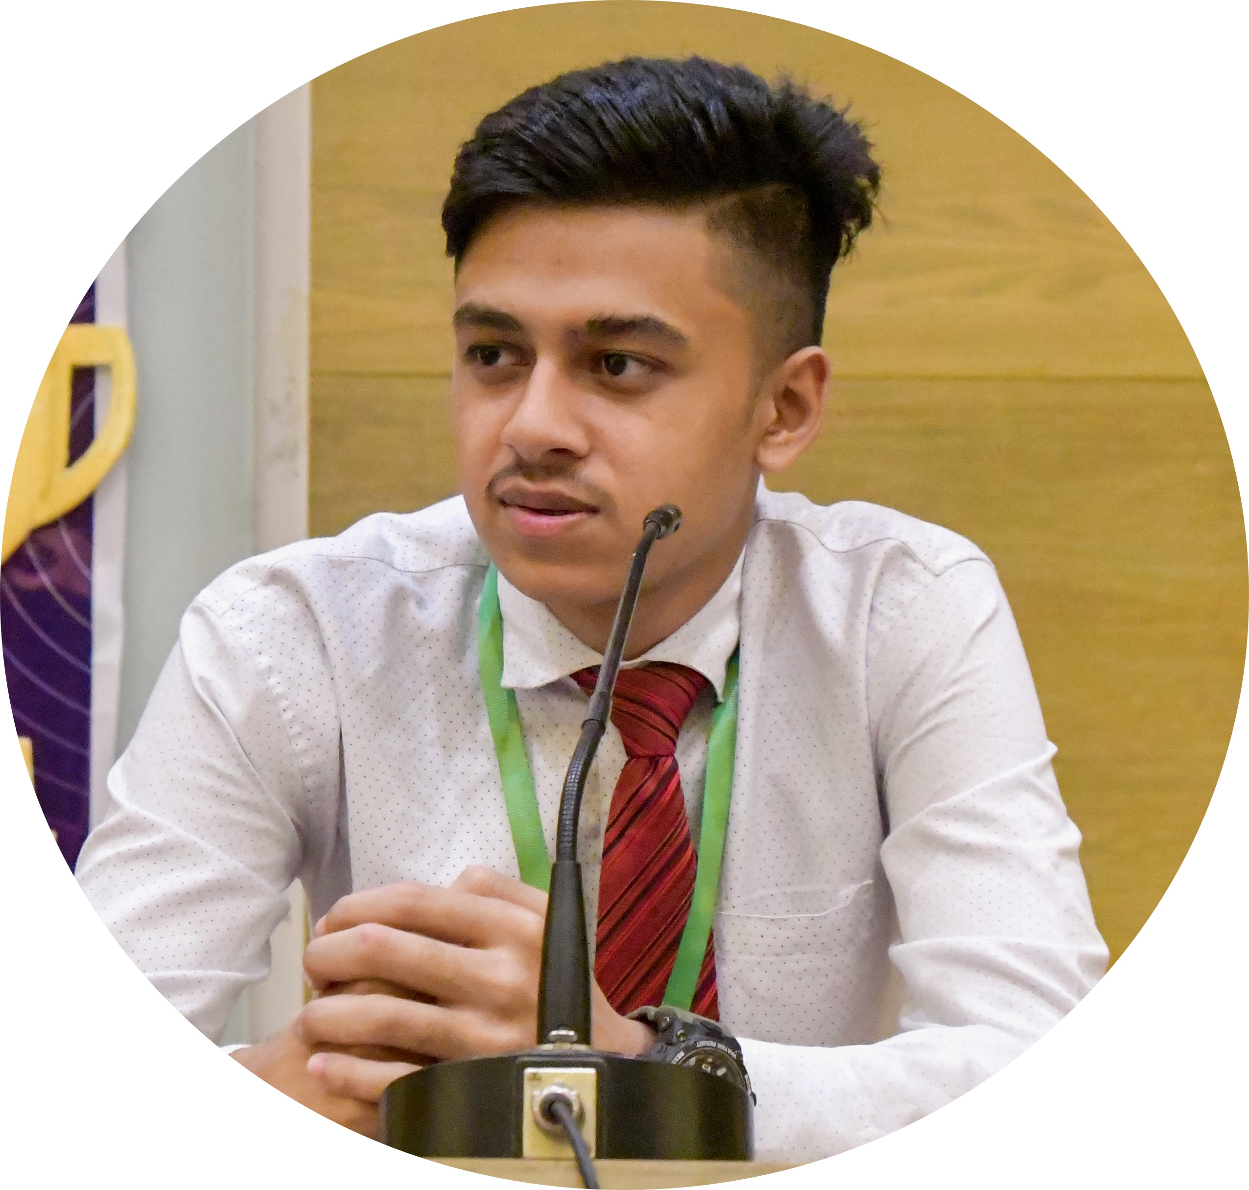
Jubayer Alam Likhon
2021-2-60-071
Ramisa Hossain Arna
2021-2-60-002
Hredoy Majumder
2020-2-60-051
MD Sanwarul Islam
2021-2-60-021

Slide 3

Project Title & LOGO
RED CYCLE

Slide 4
Project Topic
Online Blood Donation Management
Blood donation is a crucial act of human compassion, saving countless lives every year. However, traditional blood donation systems often face challenges in efficiently tracking donors, maintaining accurate blood inventories, and facilitating timely responses to emergency requests. An online blood donation management system can address these challenges by streamlining processes and connecting potential donors with patients in need more effectively.

Slide 5
Objective
The objective of Red Cycle, an Online Blood Donation Management System, is to create a user-friendly platform that facilitates efficient blood donation processes. The system aims to connect donors with individuals in need of blood, ensuring a timely and organized exchange. Red Cycle will provide a seamless user experience, allowing users to register, log in, become donors, make blood requests, and provide valuable feedback. The system will empower administrators to oversee and manage blood requests, fostering a responsive and supportive community dedicated to saving lives through blood donation. The ultimate goal is to streamline the blood donation process, increase accessibility, and enhance communication between donors and recipients, thereby contributing to the improvement of overall healthcare systems

Slide 6
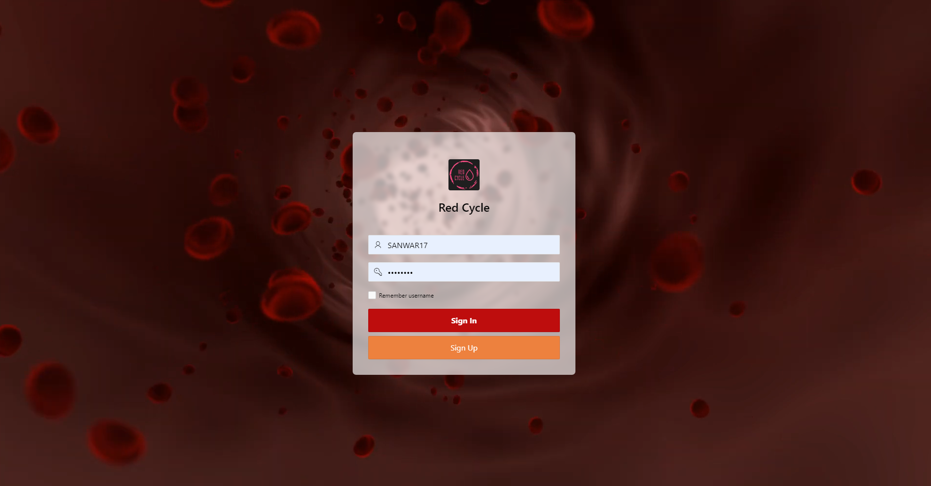
Login Page

Slide 7
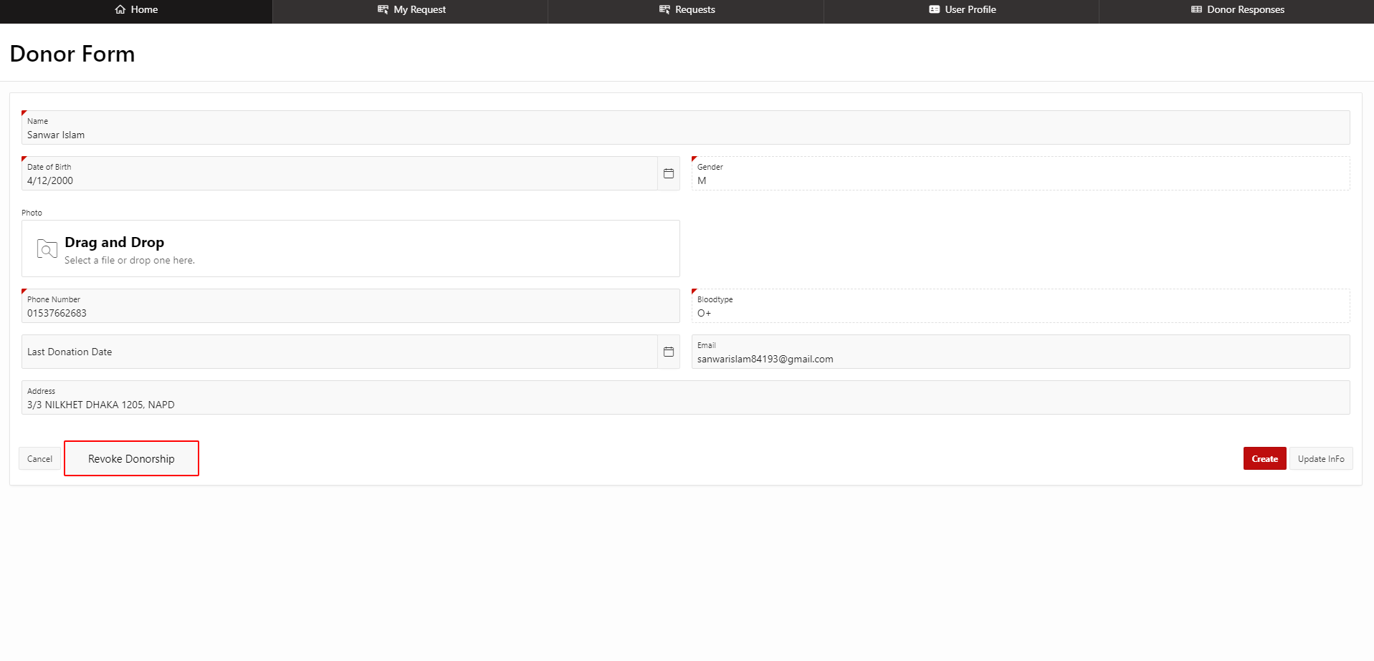
Become a Donor

Slide 8
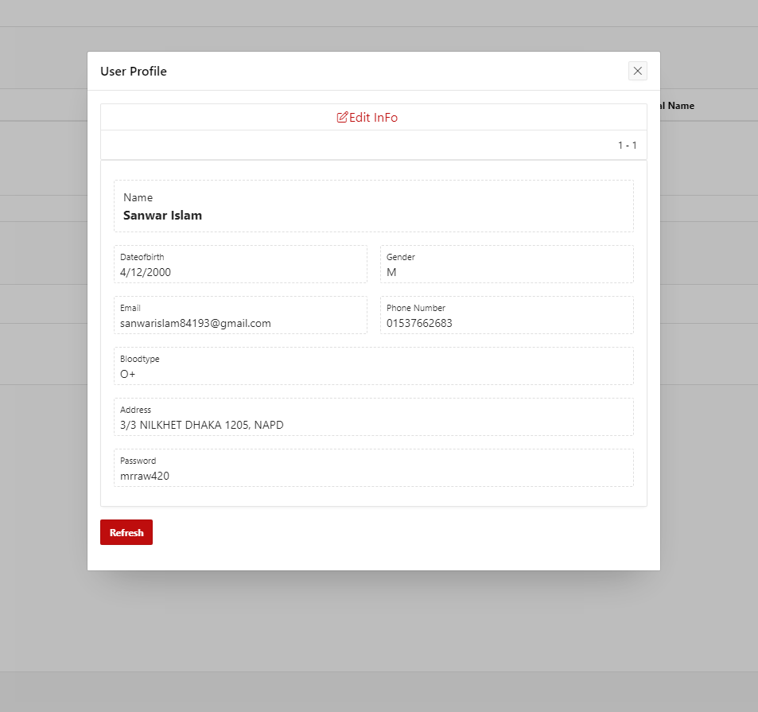
User Profile

Slide 9
Scheduling Chart
Activity | Predecessor | Duration (Days)
A = Donor Registration | -- | 2
B = Donor Management | A | 4
C = Blood Information | A | 2
D = Communication | C | 4
E = Administration | -- | 3
F = Support and Help | E | 2
G=Donor Tracking | B | 2
H=Donor Feedback | B | 1
I=Public Awareness | E | 2
J=Report and Analysis | B, D | 6

Slide 10
CPM (Activity on Node)
ES
EF
6
8
G 2
LS
LF
12
14
6
9
2
6
H 1
B 4
0
13
14
8
14
FINISH
2
START
A 2
4
8
J 6
4
8
0
2
4
D 4
8
14
2
C 2
14
4
8
0
3
2
4
3
8
E 3
F 2
9
12
12
14
3
5
I 2
12
14

Slide 11
Total Float
Critical Path Calculation
Task | Float
A | 0
B | 2
C | 0
D | 0
E | 9
Task | Float
F | 9
G | 6
H | 7
I | 9
J | 0

Slide 12
Use Case Diagram
Login
<<include>>
Sign Up
<<include>>
<<include>>
Request for Blood
<<extend>>
Become a Donor
Feedback
USER
ADMIN
View Request
User Management

Slide 13
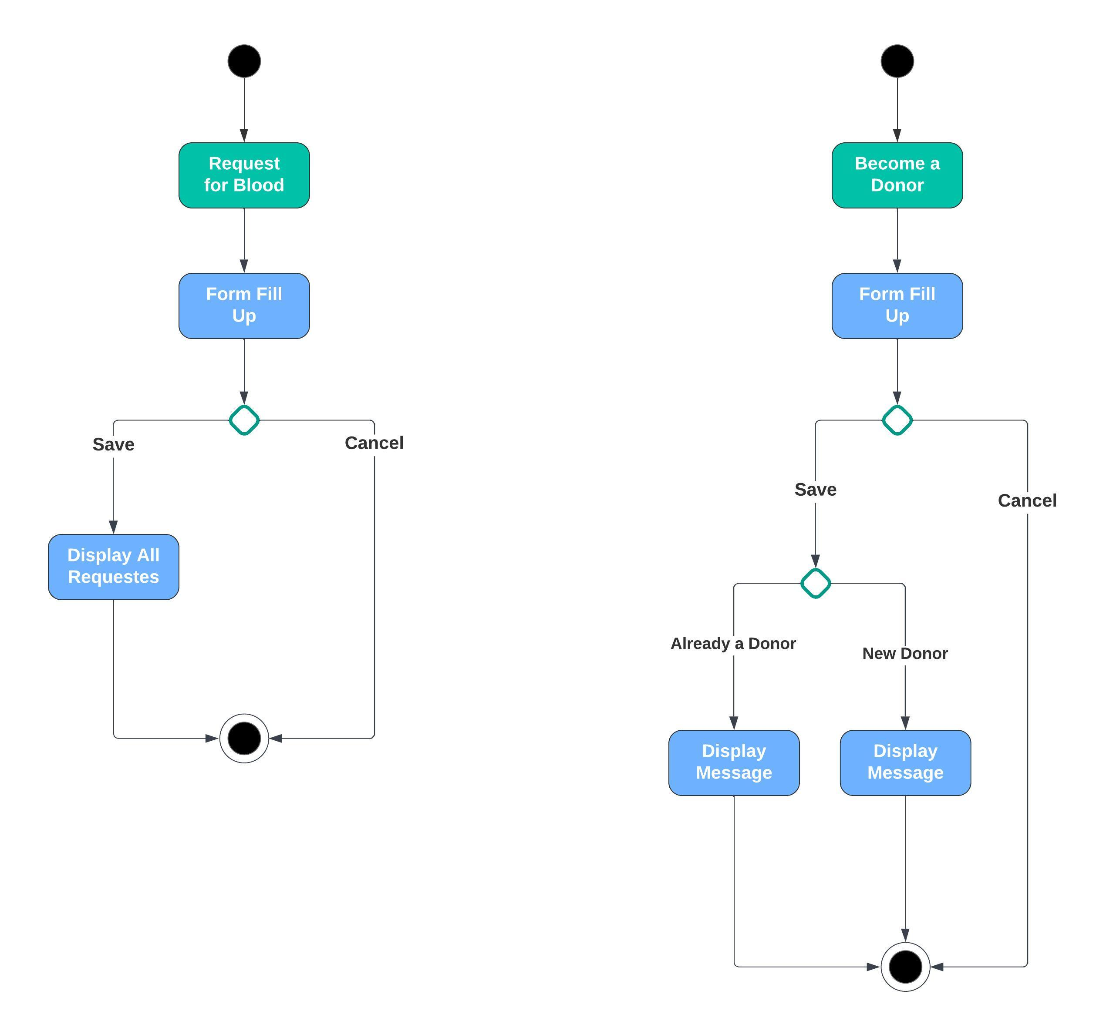
Activity Diagram

Slide 14
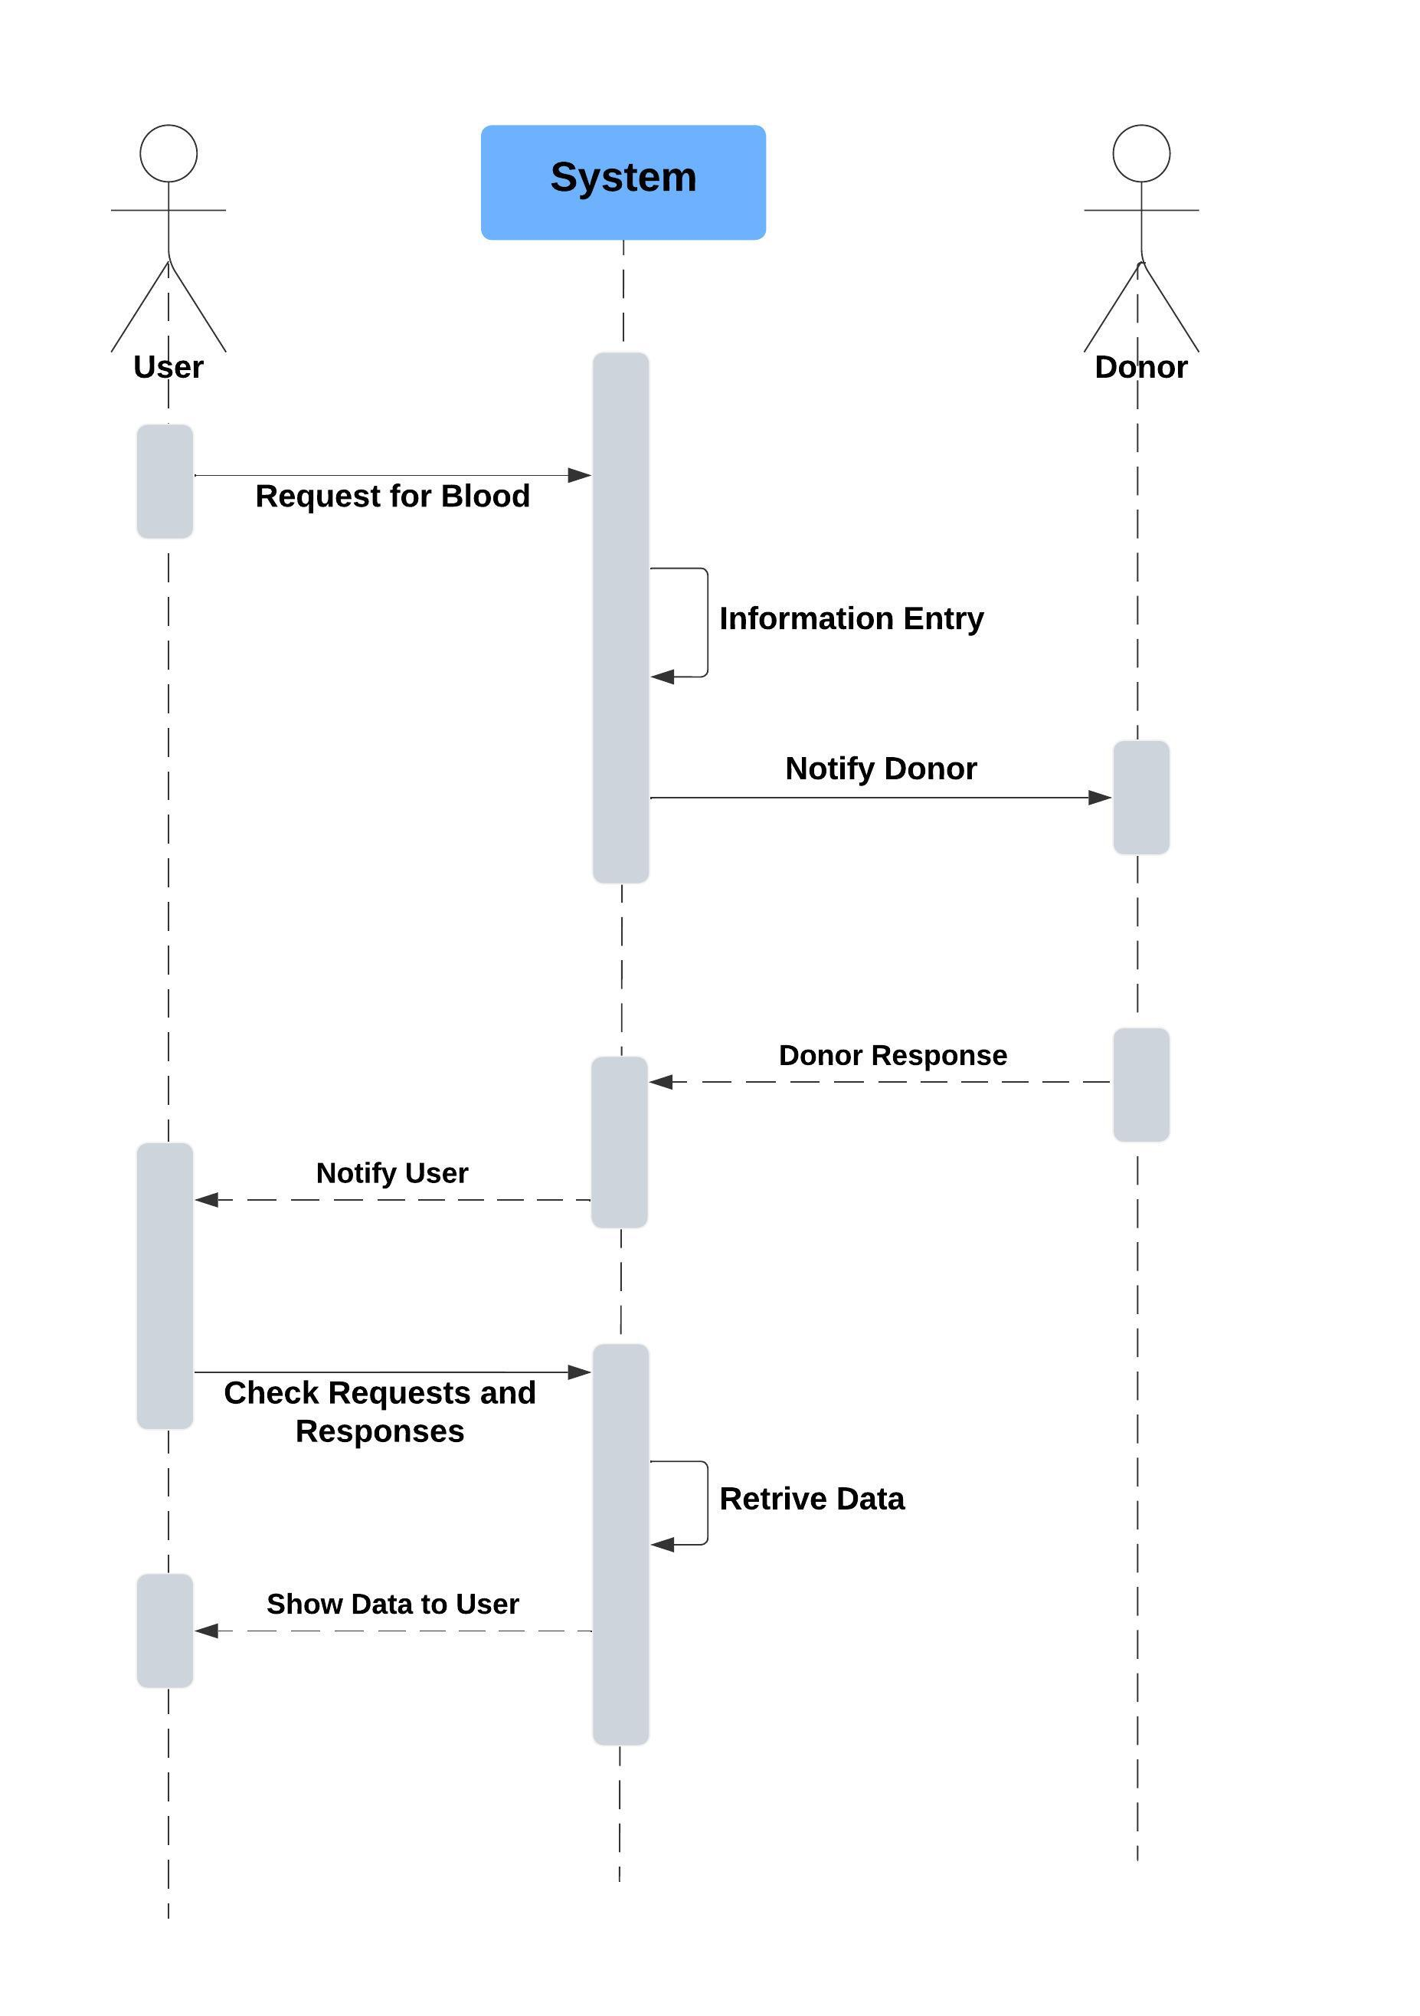
Sequence Diagram

Slide 15
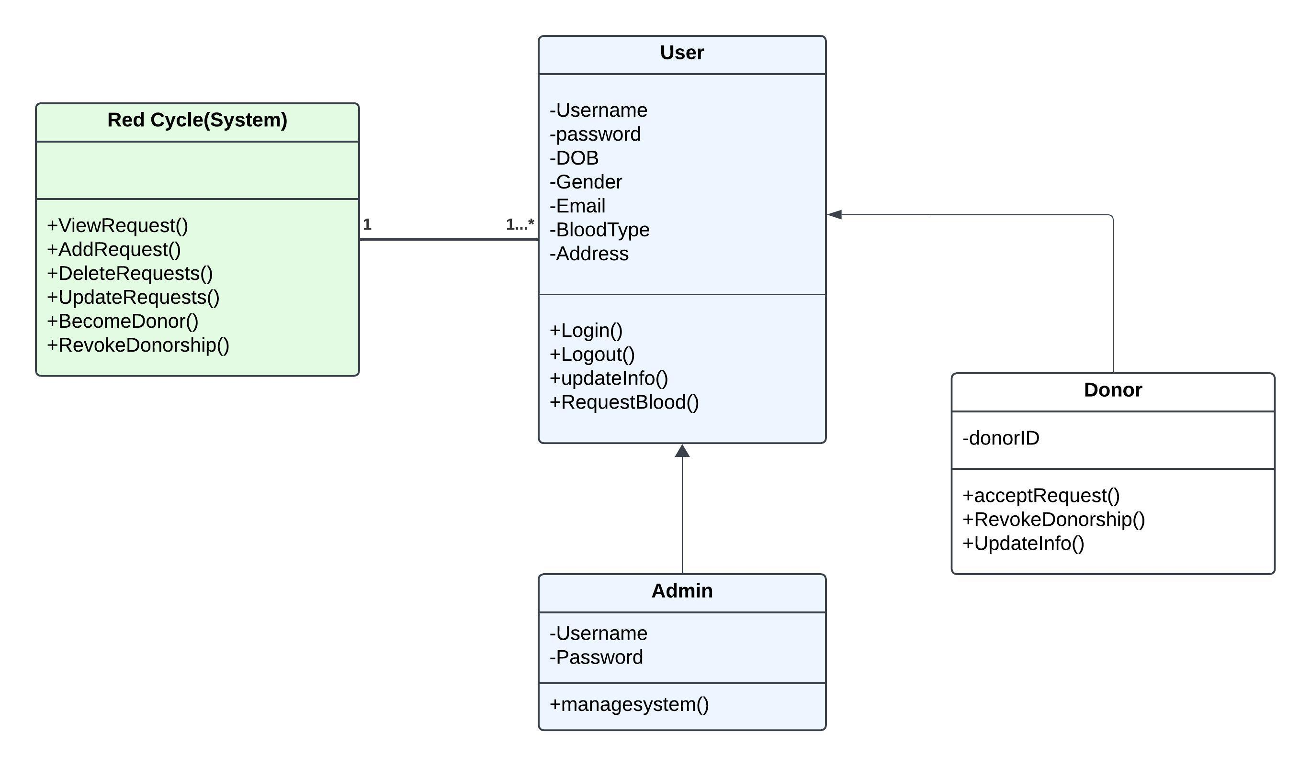
Class Diagram

Slide 16
THANK YOU ☺

